Slide 1
Names 102 – Documenting a name
Presented by
Yehuda ben Moshe
Elmet Herald
Notes:
This is

Slide 2
Introduction
Reference material:
How to Document a Name (not quite within an inch of its life) by Mistress Juliana de Luna
http://medievalscotland.org/jes/DocumentingAName.shtml
Alys's Guide to Picking and Documenting an SCA Name by Mistress Alys Mackyntoich
http://alysprojects.blogspot.com/2014/01/alyss-guide-to-picking-and-documenting.html

Slide 3
Requirements
AH V.B.2.d
A summary of all supporting evidence provided for the submission must be included on the Letter of Intent. Such evidence includes documentation, permissions to conflict, proofs for entitlement, … In the case of resubmissions or appeals, a history of previous submissions to the College of Arms, including the dates and grounds for previous returns must be included; including the full text of relevant previous returns is highly recommended. … The letter should include specific references for all supporting documentation (URLs, headings, page numbers). Omission of any part of this summary of documentation may make registration impossible and is grounds for return.

Slide 4
Requirements
What must be documented?
Each name element
See the Names 101 class and SENA PN.1/NPN.1 for info on sources of name elements
Overall construction of name
See the Names 101 class, SENA PN.2/NPN.2 and Appendices A and C

Slide 5
Sources
What makes a good source?
Primary sources
Scans of actual, original period documents
Not necessarily transcriptions, unless one is sure the text is unaltered
Spelling not normalized/modernized
Most history texts normalize names
Look at introduction to see if name normalization is discussed
If there are multiple spellings of the same name present, that’s a good indicator that names aren’t normalized

Slide 6
Sources
What makes a good source?
Dated forms
Dates need to be before 1650, or better yet before 1600
Designations such as “ancient Irish” or “medieval name” aren’t acceptable
Reliable source
Scholarly and academic works are good
SCA-specific articles are usually good
Genealogical data, baby name books are generally not reliable enough

Slide 7
Sources
Photocopy vs. no-photocopy sources
See AH Appendix H for list of no-photocopy sources
FamilySearch/IGI is no-photocopy though it’s not on the list
For all other sources, a copy must be included
For books or long articles, include the title page, the page where the elements appear, and any other relevant pages
For websites, print the website, a URL is not enough

Slide 8
Sources
Some good general sources:
Articles on heraldry.sca.org under the “Articles” tab
No-photocopy
Generally acceptable with no further requirements
Numbered reports on s-gabriels.org
No-photocopy
Be careful of early ones
Articles on s-gabriels.org
Photocopy required
Generally acceptable with no further requirements

Slide 9
Sources
Some good general sources:
Name books
Be careful when buying books
See AH Appendix F for list of books that are not acceptable
Do not use AH Appendix H as a shopping list – it’s a list of books commonly available in the College of Arms, not necessarily useful books
Many books are out of print but available used
I have created a list of books, sorted by usefulness, based on the 2013 Pennsic Book Request List – it can be found at yehudaheraldry.com
Exercise caution – the list is hardly definitive

Slide 10
Sources
Some good general sources:
OSCAR
An excellent first step is to search OSCAR for a name element you want
If it’s there, check if the name was registered
If it was registered, you can just steal borrow the documentation

Slide 11
Sources
Some good general sources:
FamilySearch
Formerly International Genealogical Index (IGI)
https://familysearch.org/search
Large database of genealogical information
Contains contributed and indexed information – we only use the indexed data which comes from late period church and other records
Search by date, place, event type
I recommend searching “1000-1650”, any event, any location

Slide 12
Sources
Some good general sources:
FamilySearch
Rules for using FamilySearch are in the Cover Letters of the June 2011, Sep 2012, May 2013, and Jan 2014 LoARs
Must come from the following batches:
B, C, J, K, M (except M17 and M18), or P
If no batch number listed, or batch is all numbers, the record is not acceptable
Article on using FamilySearch is available here: http://heraldry.sca.org/names/familysearch.html

Slide 13
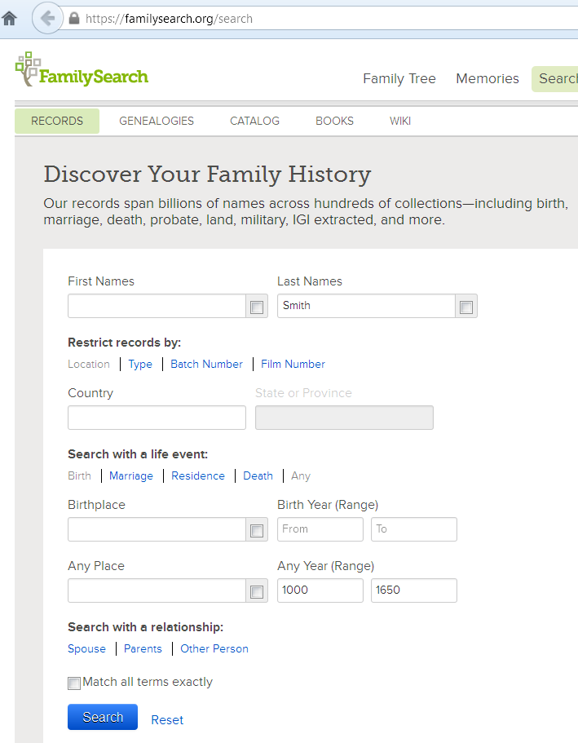
Sources
URL
Make sure
“RECORDS”
selected
Enter name
Click
“Any”
Optional
Enter dates

Slide 14
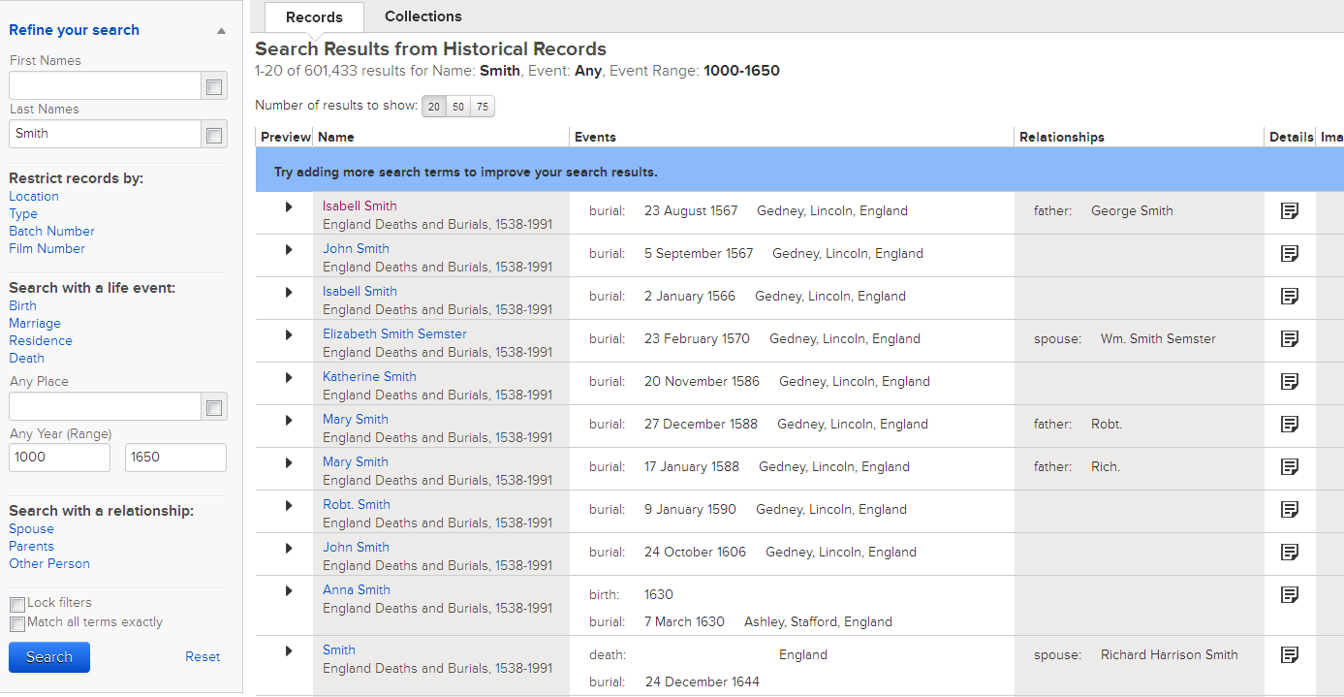
Sources

Slide 15
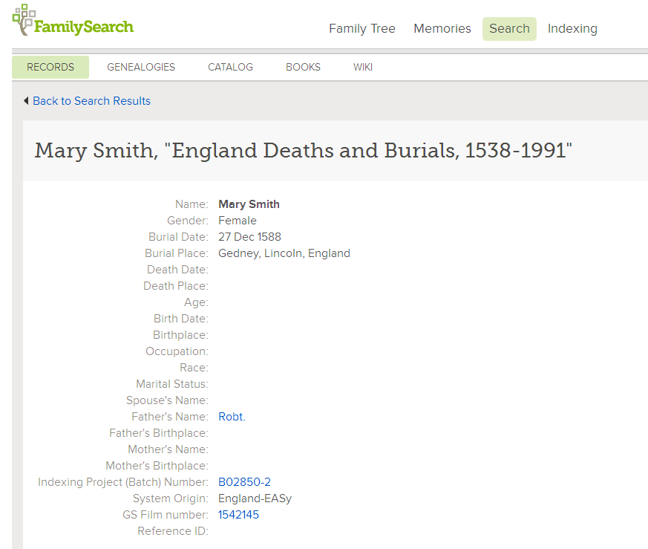
Sources
Batch Number

Slide 16
Sources
Some good general sources:
FamilySearch
When citing FamilySearch, must include gender, date, place, and batch number
I include more:
Mary – From FamilySearch, “Mary Smith”, Female, Burial, 12/27/1588, Gedney, Lincoln, England, Batch # B02850-2, https://familysearch.org/pal:/MM9.1.1/NLVT-GYN
This gives the commenters and Pelican the most possible information to work from.

Slide 17
Sources
A not-so-good general source:
LoARs/Collected Precedents
Use caution
Old LoARs may not be enough – anything more than 10 years old is suspect
Beware of “SCA-Compatible” names – those haven’t been registerable since 2009
Registration with no comment is not documentation
Prior registration is not a guarantee of future registration, or
We aren’t bound to repeat our mistakes
If a specific source is listed, that may be useful

Slide 18
What to include in documentation
If it’s a photocopy source, include the photocopies!
URL, or photocopy is not enough – you must summarize the documentation
Failing to summarize is grounds for an administrative return
Be truthful
Exaggerating the value of the source isn’t helpful – it will be checked

Slide 19
What to include in documentation
Include the following
The name of the source
If it’s a no-photocopy source, use the standard abbreviation
If it’s a book or article, include name of book, author, and edition – enough that we can find it
If it’s an internet resource, please include the URL – makes it easier for commenters to verify
A summary of all relevant information – what does the source say, what dates does it list, what relevant name forms are listed
Do not just list a page number or section name
For descriptive/occupational names, include meaning
A conclusion, explaining why this source supports the submission

Slide 20
What to include in documentation
Example of inadequate documentation:
Ivan Baranov
Ivan: Wickenden, found at http://heraldry.sca.org/names/paul/h-j.html
Baranov: Wickenden, found at http://heraldry.sca.org/names/paul/ba.html
Problems:
Sources not adequately summarized
Construction not explained

Slide 21
What to include in documentation
Example of good documentation:
Ivan Baranov
Ivan: Paul Goldschmidt's Dictionary of period Russian Names 2nd edition, section MA, s.n. Ioann (m) – Russianization of John, Variant: Ivan (Ivan Fomin syn, 1181-2), found at http://heraldry.sca.org/names/paul/h-j.html
Baranov: Paul Goldschmidt's Dictionary of period Russian Names 2nd edition, section BA, s.n. Baran (m) – “ram”, Patronymic: Baranov (“Maysh Baranov syn Ovtsyn”, 1500), found at http://heraldry.sca.org/names/paul/ba.html
Construction: Paul Goldschmidt's Dictionary of period Russian Names 2nd edition,, Grammar, lists the pattern “G-P” (given name + patronymic). Ivan is a given name, Baranov is a patronymic. As it is already in patronymic form, it need not be modified. See: http://heraldry.sca.org/names/paul/zgrammar.html

Slide 22
What to include in documentation
Some other problems
Not listing the name formation pattern
My recommendation is to always list the formation pattern
Most are found in SENA Appendix A
Even if it’s something obvious, like “John Smith”, include “SENA Appendix A lists the pattern “given+byname” as acceptable in Early Modern English”
Not referring to Appendix C to show that a mix of two language groups is acceptable
“English and French are an acceptable lingual mix under SENA Appendix C”

Slide 23
What to include in documentation
Some other problems
Not including any documentation at all
Wikipedia
Ok for generally acceptable facts, not ok for name elements
May be a good place to start research – look at the citations
Websites such as “Behind the Name”, genealogy sites, or sites that try to sell you things about family history

Slide 24
What to include in documentation
Some more examples:
For the name Eoin Ó Mathghamhna
"Quick and Easy Gaelic Names (3rd Ed.)" by Sharon Krossa (http://www.medievalscotland.org/scotnames/quickgaelicbynames/#clanaffiliationbyname) sets out the pattern for clan affiliation-style bynames as: <single given name> Ó <eponymous clan ancestor's name (in genitive case)>
Eoin is an Early Modern Irish Gaelic name with 58 Annals dates between 1246 and 1600, appearing in "Index of Names in Irish Annals" by Kathleen O’Brien (http://www.medievalscotland.org/kmo/AnnalsIndex/Masculine/Eoin.shtml)
Mathghamhain is also found in “Index of Names in Irish Annals” (http://www.medievalscotland.org/kmo/AnnalsIndex/Masculine/Mathgamain.shtml), with Annals dates of 1255, 1266, 1271, 1314, 1461, 1472, 1483, 1489, 1588. Mathghamhain is the nominative form; Mathghamhna is the genitive form.

Slide 25
What to include in documentation
Some more examples:
For the name Mergery Potticary
Mergery is found in “English Given Names from 16th and Early 17th C Marriage Records” by Aryanhwy merch Catmael (http://heraldry.sca.org/names/english/parishes/parishes.html) s.n. Margery dated to 1583.
Potticary appears in Bardsley, A Dictionary of English and Welsh Surnames, p. 617 s.n. Potticary, with this spelling dated to 1591.
This naming pattern for English names is found in Appendix A of SENA.

Slide 26
What to include in documentation
Some more examples:
For the name Meliana Trinidad de Valero
The pattern given + byname + de + locative for Spanish names is found in Appendix A of SENA. All elements are found in the Family Search Historical Records:
Meliana Lopez; Female; Marriage; 12 Nov 1599; Nuestra Señora De La Consolación, Ballesteros De Calatrava, Ciudad Real, Spain; Batch: M86466-1
Ana Trinidad; Female; Christening; 30 Jan 1564; San Juan Evangelista, Villafrades de Campos, Valladolid, Spain; Batch: C02523-2
Gonzalo De Valero; Male; Christening; 22 Sep 1567; San Andrés, Valladolid, Valladolid, Spain; Batch: C87100-1

Slide 27
Specific Sources
English
For late period, FamilySearch
Books are great here:
Given names: E. G. Withycombe, The Oxford Dictionary of English Christian Names, 3rd ed.
Surnames:
Reaney, P. H., & R. M. Wilson, A Dictionary of English Surnames
Bardsley, A Dictionary of English and Welsh Surnames
Placenames
Victor Watts The Cambridge Dictionary of English Place-Names. (expensive but very good)
A.D. Mills Oxford Dictionary of British Place Names.

Slide 28
Specific Sources
English
Online:
Talan Gwynek's "Feminine Given Names in A Dictionary of English Surnames" (http://www.s-gabriel.org/names/talan/reaney/)
Surnames: Many articles on St. Gabriel’s
Middle English Dictionary (MED)
http://quod.lib.umich.edu/m/med/structure.html
Good for descriptive, occupational, and place-name bynames
Search for the relevant word and look in the citations for use as a name
Anglo-Saxon
Proposography of Anglo-Saxon England (PASE): http://pase.ac.uk/jsp/index.jsp

Slide 29
Specific Sources
Welsh
Online
Tangwysyl verch Morgant Glasvryn, "A Simple Guide to Constructing 13th Century Welsh Names" (http://heraldry.sca.org/names/welsh13.html)
Tangwysyl verch Morgant Glasvryn, "A Simple Guide to Constructing 16th Century Welsh Names (in English Contexts)" (http://heraldry.sca.org/names/welsh16.html)
Books
T. J. and Prys Morgan's Welsh Surnames
Bardsley, A Dictionary of English and Welsh Surnames
Notes:
Florence represents the Tuscan dialect which evolved into modern Italian

Slide 30
Specific Sources
Gaelic
Starting place:
Effric Neyn Kenȝocht Mcherrald, "Quick and Easy Gaelic Names" (http://medievalscotland.org/scotnames/quickgaelicbynames/)
Effric Neyn Kenȝocht Mcherrald, “The Spelling of Lenited Consonants in Gaelic” (http://medievalscotland.org/scotlang/lenition.shtml)
Online:
Mari ingen Briain meic Donnchada (or Mari Elspeth nic Bryan), "Index of Names in Irish Annals" (http://medievalscotland.org/kmo/AnnalsIndex/)

Slide 31
Specific Sources
Gaelic
Books
Ó Corrain and Maguire, Irish Names/Gaelic Names (two editions of the same book) – use with caution
Patrick Woulfe, Sloinnte Gaedheal is Gall: Irish Names and Surnames (Revised Ed.)
The italicized forms are Anglicized Irish forms that are late period or grey period; while the Gaelic forms of those dated names are early 20th century, they are generally identical to the c. 1600 forms, and are registerable
Do not use the given name section! This one is bynames only
Do not use Woulfe’s Irish Names for Children

Slide 32
Specific Sources
Scots
Books
Many English sources are applicable
Black, The Surnames of Scotland: Their Origin, Meaning and History
Greek (Byzantine)
Online
Bardas Xiphias, "Common Names of the Aristocracy in the Roman Empire During the 6th and 7th Centuries" (http://heraldry.sca.org/names/byzantine/early_byz_names.html)
Bardas Xiphias, "Personal Names of the Aristocracy in the Roman Empire During the Later Byzantine Era" (http://heraldry.sca.org/names/byzantine/introduction.html)

Slide 33
Specific Sources
French
Excellent online sources:
Aryanhwy merch Catmael, "Names from the 1292 Paris Census" (http://www.ellipsis.cx/~liana/names/french/1292paris.pdf)
Aryanhwy merch Catmael, "French Names from Paris, 1421, 1423, & 1438" (http://www.ellipsis.cx/~liana/names/french/paris1423.html)
Mari ingen Briain meic Donnchada, "Names Found in Ambleny Registers 1578-1616" (http://medievalscotland.org/kmo/Ambleny/)
Aryanhwy merch Catmael, Bynames in Medieval France (http://www.ellipsis.cx/~liana/names/french/frenchbynames.pdf)

Slide 34
Specific Sources
French
Books
Dauzat & Rostaing, Dictionnaire Etymologique des Noms de Lieux de la France
Morlet, Les Noms de Personne sur le Territoire de l'Ancienne Gaule du VIe au XIIe Siècle, vol I-III
Morlet, Etude d'anthroponymie picarde, les noms de personne en Haute Picardie aux XIIIe, XIVe, XVe siecles
Unfortunately, these are all hard to come by, expensive, and in French

Slide 35
Specific Sources
German
Online for given names
Talan Gwynek, "Medieval German Given Names from Silesia" (http://www.sca.org/heraldry/laurel/names/bahlow_v.htm)
Aryanhwy merch Catmael, "German Names from Rottweil, Baden-Württemberg, 1441" (http://www.ellipsis.cx/~liana/names/german/rottweil1441.html)

Slide 36
Specific Sources
German
Books for bynames
Bahlow/Gentry Dictionary of German Names
Josef Brechenmacher, Etymologisches Wörterbuch der Deutschen Familiennamen

Slide 37
Specific Sources
Old Norse
Geirr Bassi Haroldsson, The Old Norse Name
Probably best source to use
Available from the SCA stock clerk for $6
https://stockclerk.sca.org/ftpw.html?id=iSxusIVB (see last page)
Online:
Gunnvor silfraharr “Old Norse Names” (http://www.vikinganswerlady.com/ONNames.shtml)
Aryanhwy merch Catmael, "Viking Names found in the Landnámabók" (http://www.ellipsis.cx/~liana/names/norse/landnamabok.html)
Aryanhwy merch Catmael, "Viking Bynames found in the Landnámabók" (http://www.ellipsis.cx/~liana/names/norse/vikbynames.html)

Slide 38
Specific Sources
Russian
Paul Wickenden of Thanet‘ (Paul Goldschmidt) Dictionary of Period Russian Names (2nd Edition online - http://heraldry.sca.org/names/paul/ , 3rd Edition available from SCA stock clerk)
This is the best SCA name resource for Russian, it includes grammar, name patterns, and a huge database of names

Slide 39
Specific Sources
Spanish
Juliana de Luna, "Spanish Names from the Late 15th Century" (http://heraldry.sca.org/names/isabella/index.html)
Elsbeth Anne Roth, "16th Century Spanish Names" (http://heraldry.sca.org/names/spanish/index.html)

Slide 40
Specific Sources
Italian
Florence
Juliana de Luna, Names in 15th Century Florence and her Dominions: the Condado" (http://www.s-gabriel.org/names/juliana/condado/)
Ferrante laVolpe, "Men's names from Florence, 1427" (http://www.s-gabriel.org/names/ferrante/catasto/)
Arval Benicoeur, "Feminine Given Names from the Online Catasto of Florence of 1427" (http://www.s-gabriel.org/names/arval/catasto/)
Venice
Arval Benicoeur and Talan Gwynek, "Fourteenth Century Venetian Personal Names" (http://www.s-gabriel.org/names/arval/venice14/)
Aryanhwy merch Catmael, " Fifteenth Century Venetian Masculine Names" (http://www.ellipsis.cx/~liana/names/italian/venice.html)
Juliana de Luna, "Names from Sixteenth Century Venice" (http://www.s-gabriel.org/names/juliana/16thcvenice.html)
Notes:
Florence represents the Tuscan dialect which evolved into modern Italian

Slide 41
Final Thoughts
Registerable vs. Authentic
A submission must be registerable, it need not be authentic
While we can encourage clients to design authentic names and devices, we cannot, and should not force the decision
If a client is set on a registerable but not very authentic submission, you should process it!

Slide 42
Final Thoughts
Customer Service
It is our job to help our clients
We are here to make registrations happen, not prevent them from happening
When consulting, help clients create registerable submissions they like
When commenting, look for reasons to allow registration, not prohibit it
Heralds want a reputation for being helpful, not obstructionist!
Notes:
The college has a reputation for being a bunch of people who say “no”. Lets work against that rep.

Slide 43
About me
Elmet Herald – I am the East Kingdom heraldic education deputy
elmet@eastkingdom.org
jgalak@gmail.com
This handout can be found at:
http://www.yehudaheraldry.com/ekhu

